Slide 1
Multimedia Technology Introduction

Slide 2
What is Multimedia?
Multimedia can have many definitions these include:
(A computer system perspective)
Multimedia means that computer information can be
represented through audio, video, and animation in addition to
traditional media (i.e., text, graphics/drawings, images).

Slide 3
General Definition
A good general working definition for this module is:
Multimedia is the field concerned with the computer
controlled integration of text, graphics, drawings, still and moving images (Video), animation, audio, and any other media where every type of information can be represented, stored, transmitted and processed digitally.

Slide 4
Multimedia Application Definition
A Multimedia Application is an application which uses a
collection of multiple media sources e.g. text, graphics, images,
sound/audio, animation and/or video.

Slide 5
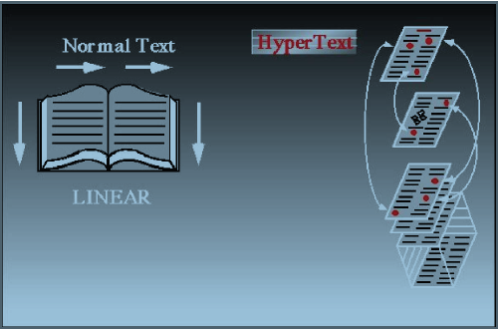
What is HyperText and HyperMedia?
Hypertext is a text which contains links to other texts.
The term was invented by Ted Nelson around 1965.
This has implications in layout and organization of material —
and depends a lot on the application at hand.

Slide 6
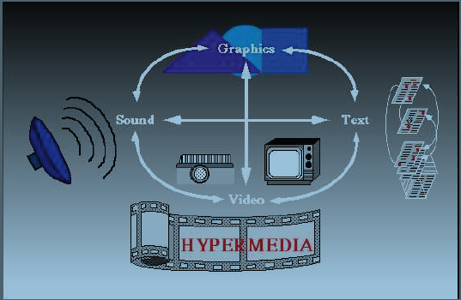
Hypermedia
HyperMedia is not constrained to be text-based. It can include
other media, e.g., graphics, images, and especially the continuous media – sound and video.

Slide 7
Example of Hypermedia Applications?
The World Wide Web (WWW) is the best example of a
hypermedia application.
Powerpoint
Adobe Acrobat (or other PDF software)
Adobe Flash
Many Others

Slide 8
Multimedia Applications
Examples of Multimedia Applications include:
World Wide Web
Multimedia Authoring, e.g. Adobe/Macromedia Director
Hypermedia courseware
Video-on-demand
Interactive TV
Computer Games
Virtual reality
Digital video editing and production systems
Multimedia Database systems

Slide 9
Hypertext Transfer Protocol(HTTP)
Originally designed for transmitting hypermedia, but also supports transmission of any file type.
Stateless request/response protocol

Slide 10
Hypertext Markup Language(HTML)
Language for publishing hypermedia on the WWW.
<HTML>
<HEAD>
………..
</HEAD>
<BODY>
………..
</BODY>
</HTHL>

Slide 11
Example
<HTML>
<HEAD>
<TITLE>
A sample web page.
</TITLE>
</HEAD>
<BODY>
<P>
We can put any text we like here, since this is
a paragraph element.
</P>
</BODY>
</HTML>

Slide 12
Extensible Markup Language
Modularity of data, structure and views.
We would like a user or an application to be able to define the tags(structure) allowed in a document and their relationship to each other, in one place, then define data using these tags in another place and, finally, define in yet another document how to render the tags.

Slide 13
Conditions
XML syntax looks like HTML syntax, although it is much stricter.
All tags are lowercase, and a tag that has only inline data has to terminate itself, for example, <token params />.

Slide 14
Multimedia Systems
A Multimedia System is a system capable of processing
multimedia data and applications.
A Multimedia System is characterized by the processing,
storage, generation, manipulation and rendition of Multimedia
information.

Slide 15
Characteristics of a Multimedia System
A Multimedia system has four basic characteristics:
Multimedia systems must be computer controlled.
Multimedia systems are integrated.
The information they handle must be represented digitally.
The interface to the final presentation of media is usually
interactive.

Slide 16
Challenges for Multimedia Systems
Distributed Networks
Temporal relationship between data
– Render different data at same time — continuously.
– Sequencing within the media
playing frames in correct order/time frame in video
– Synchronization — inter-media scheduling
E.g. Video and Audio — Lip synchronization is clearly
important for humans to watch playback of video and audio
and even animation and audio.
Ever tried watching an out of (lip) sync film for a long time?

Slide 17
Key Issues for Multimedia Systems
The key issues multimedia systems need to deal with here
are:
How to represent and store temporal information.
How to strictly maintain the temporal relationships on play
back/retrieval
What process are involved in the above.
Data has to represented digitally — Analog–Digital
Conversion, Sampling etc.
Large Data Requirements — bandwidth, storage,
Data compression is usually mandatory

